Slide 1
22th July 2022 Presentation
Yufeng Gao, Juntuo Wang

Slide 2
Overview
Deeper backbone
Using attention layer in the model through ResNeSt
DC-Unet

Slide 3
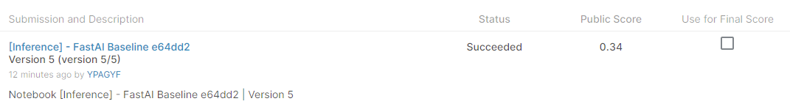
Deeper Backbones
At the end of the last presentation, we suggested that deepening the number of layers in the backbone might have a beneficial effect on the overall performance of the model.
Hence we tried the deeper backbones (compared to SE-ResNet50 and ResNet50) which are SE-ResNet101 and ResNet101
The dice coefficient value has been improved from 83% to 85%. However, the overall score of the competition (on the inference notebook) is reduced from 0.68 to 0.34.

Slide 4
Applying the attention-related model for the first time
Before this week’s attempt , the attention-related model has never been used in our segmentation task.
The overall structure of UNeXt has been very mature now
Hence it seems to be a good idea to apply the attention-related in the backbone part and the skip connection part.

Slide 5
ResNeSt Model
The full name of the ResNeSt Model is Split attention networks
It successfully improved the segmentation performance of the DeepLabV3 (improve the mIoU value from about 42% to about 45%) and achieved the high accuracy of 81% on the ImageNet.
The structure can be summarized as a combination of ResNet and split attention mechanism. Its can be accessed in 2004.08955v2.pdf (arxiv.org)

Slide 6
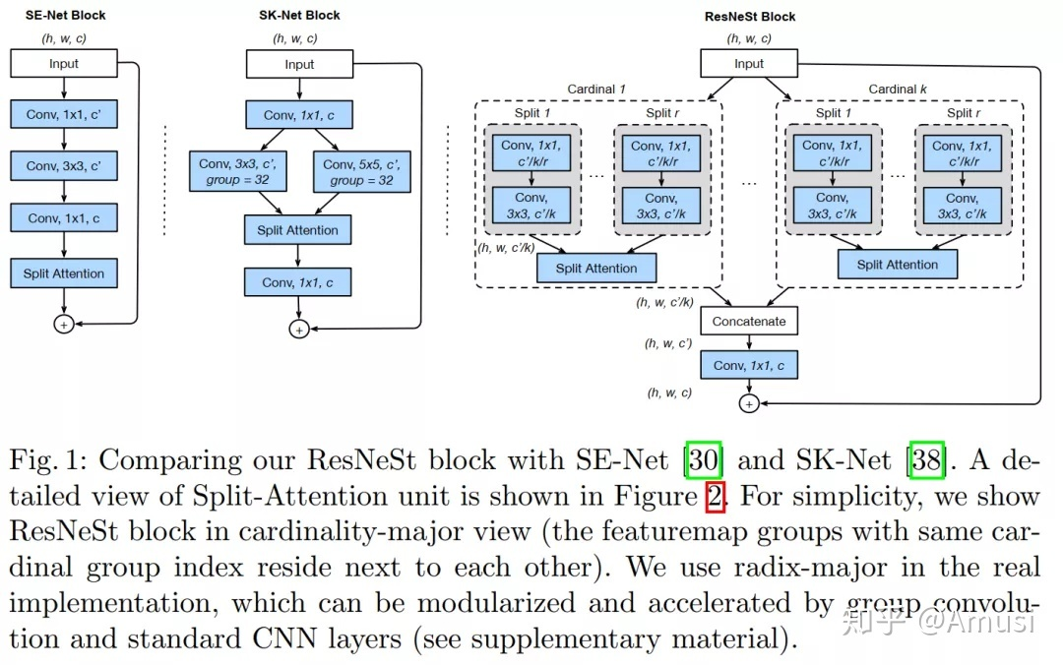
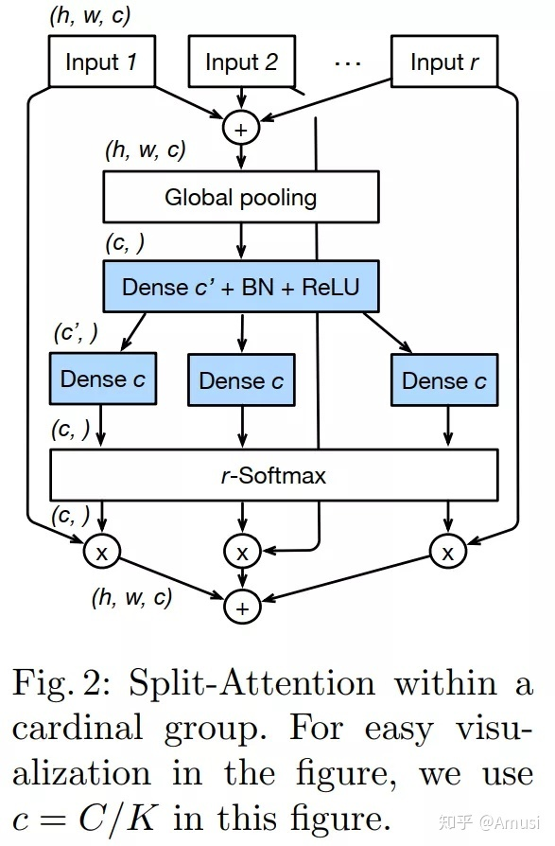
ResNeSt Model
The full name of the ResNeSt Model is Split attention networks

Slide 7
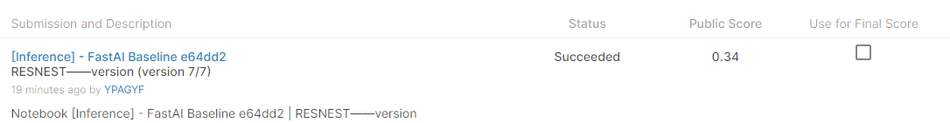
Results-ResNeSt
The Dice coefficient value has been improved from 83% (ResNet50 as the backbone) to 84.8%(ResNeSt as the backbone), this value is especially high when we freeze the model in the process of training. However, the score of the competition decreased from 0.68 to 0.34.

Slide 8
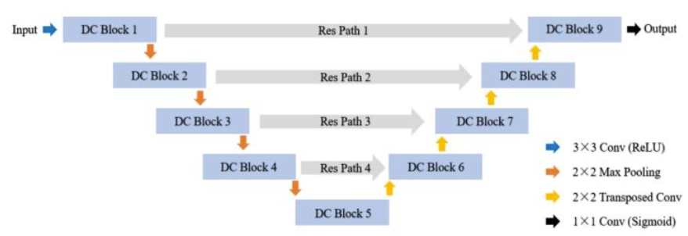
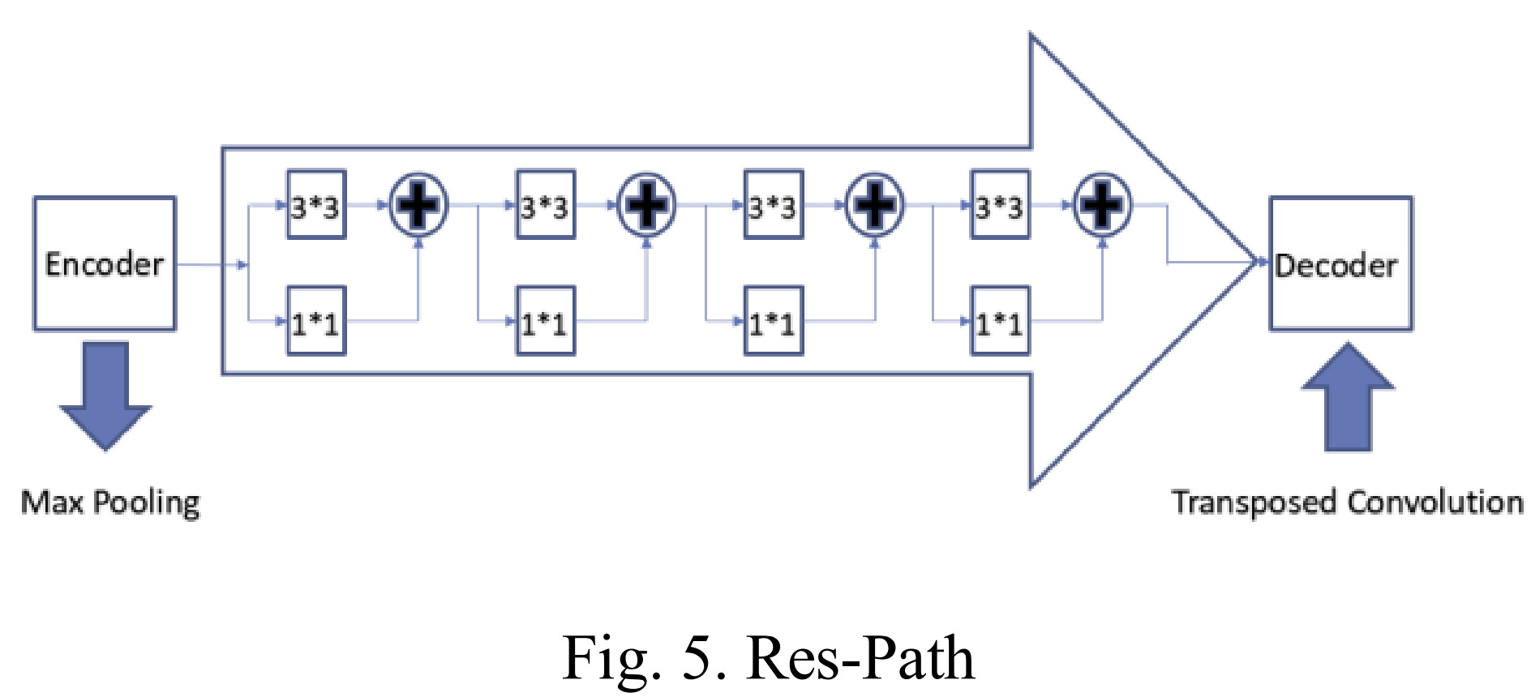
DC-Unet
The overall structure of the DC-Unet is very similar to that of the UNet. The differences lie in that the ResPath substitute the original skip connection and that the
ResPath has been shown in the figure on the right side

Slide 9
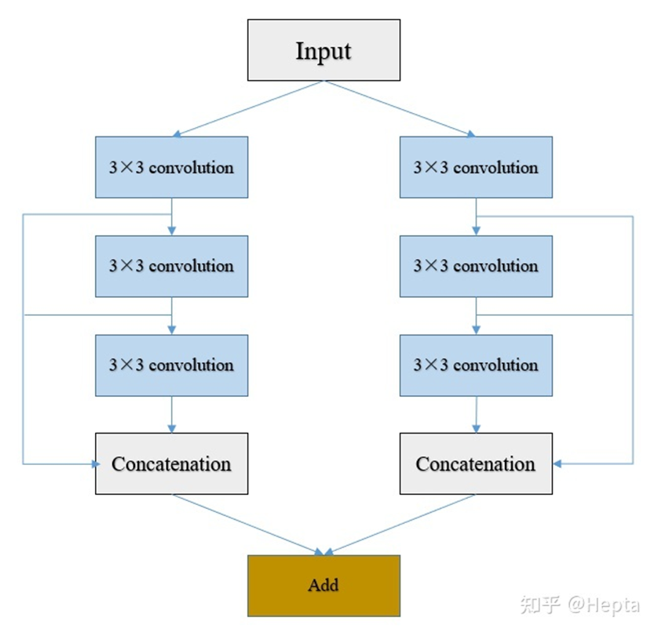
DC-Unet (detailed structures)
The figure on the right side demonstrate the structure of the Dual-Channel block.

Slide 10
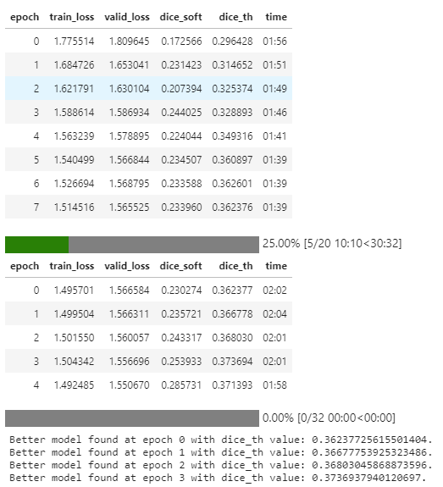
Results of DC-UNet
Performance is very bad, the dice coefficient value is even lower than that of the FPN model, let alone UNet the final score is lower than 0.2
We suppose that there may be something wrong with the code and we will try to fix it ASAP.

Slide 11
Conclusion
For the backbone part, increasing the complexity will improve the dice coefficient value but decrease the final score of the competition. Hence we suppose that
Introducing the attention mechanism in the backbone part backfires. Follow-up work related to attention may focus on the skip connection and the decoder part.
DC-Unet’s performance may be even worse than that of the Unet, but we will validate its viability later

Slide 12
Future Plan
Trying to write our own code for training and data reading so that we can run any model we want on top of it.
Validate the viability of dual connection in the U-NeXt structure.
Try some new models like VIT which is not based on the Unet structure.

